Slide 1
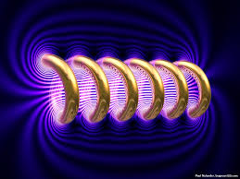





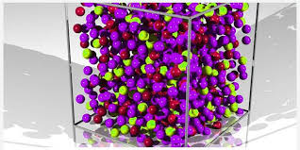
Engineering Physics
PHY-109
Waves-4
ELECTROMAGNETIC THEORY
QUANTUM MECHANICS
LASER
WAVES
Dr. Jeeban Pd Gewali
Department of Physics
Lovely Professional University
Phagwara, Punjab-144411
SOLID STATE PHYSICS
FIBER OPTICS

Slide 2
Syllabus
Interference phenomenon and Concept of resonance.
Audible, ultrasonic and infrasonic waves. Production of ultrasonic waves by magnetostriction method.
Ultrasonic transducers and their uses, applications of ultrasonic waves, detection of ultrasonic waves (Kundt's tube method, sensitive flame method and piezoelectric detectors).
Absorption and Dispersion of ultrasonic waves.
Superposition of two waves, sound wave and its velocity, standing waves, Formation of beats, Supersonic and shock waves.

Slide 3
Sound waves and its velocity
How is the sound wave generated?
When we speak, we exert a pressure on the air molecules. Because of this compression takes place. The moment they are compressed, they tend to regain their original position. However, due to inertia they cross the equilibrium position and overshoot the equilibrium position. Due to this overshooting rarefactions are produced. Thus the particles of the medium executes simple harmonic oscillation about their mean position, while the sound wave propagates.
** In solid and elastic medium however, both longitudinal and transverse sound waves are possible

Slide 4
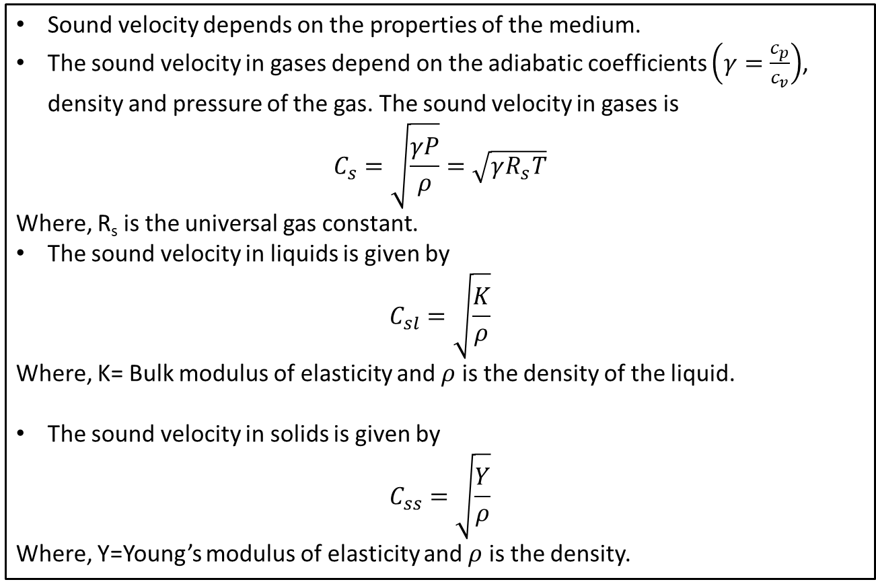
Sound waves and its velocity
Sound velocity depends on the properties of the medium.
The sound velocity in gases depend on the adiabatic coefficients $\left(γ=\frac{c_{p}}{c_{v}}\right)$, density and pressure of the gas. The sound velocity in gases is
$$C_{s}=\sqrt{\frac{γP}{ρ}}=\sqrt{γR_{s}T}$$
Where, R_{s} is the universal gas constant.
The sound velocity in liquids is given by
$$C_{sl}=\sqrt{\frac{K}{ρ}}$$
Where, K= Bulk modulus of elasticity and $ρ$ is the density of the liquid.
The sound velocity in solids is given by
$$C_{ss}=\sqrt{\frac{Y}{ρ}}$$
Where, Y=Young’s modulus of elasticity and $ρ$ is the density.

Slide 5
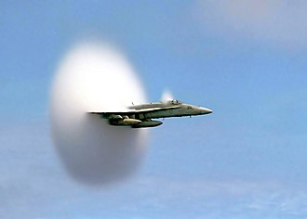
Sound waves and its velocity
Mach number:
the ratio of the speed of a body to the speed of sound in the surrounding medium.
Subsonic: Subsonic conditions occur for Mach numbers less than one, M < 1 . For the lowest subsonic conditions, compressibility can be ignored.
Transonic: As the speed of the object approaches the speed of sound, the flight Mach number is nearly equal to one, M = 1, and the flow is said to be transonic. Compressibility effects are most important in transonic flows and lead to the early belief in a sound barrier.
Supersonic: Supersonic conditions occur for Mach numbers greater than one, 1 < M < 3. Compressibility effects are important for supersonic aircraft, and shock waves are generated by the surface of the object.
Hypersonic: For speeds greater than five times the speed of sound, M > 5, the flow is said to be hypersonic. At these speeds, some of the energy of the object now goes into exciting the chemical bonds which hold together the nitrogen and oxygen molecules of the air. At hypersonic speeds, the chemistry of the air must be considered when determining forces on the object. The Space Shuttle re-enters the atmosphere at high hypersonic speeds, M ~ 25. Under these conditions, the heated air becomes an ionized plasma of gas and the spacecraft must be insulated from the high temperatures.
U.S. Navy F/A-18 traveling near the speed of sound. The white halo consists of condensed water droplets formed by the sudden drop in air pressure behind the shock cone around the aircraft.

Slide 6
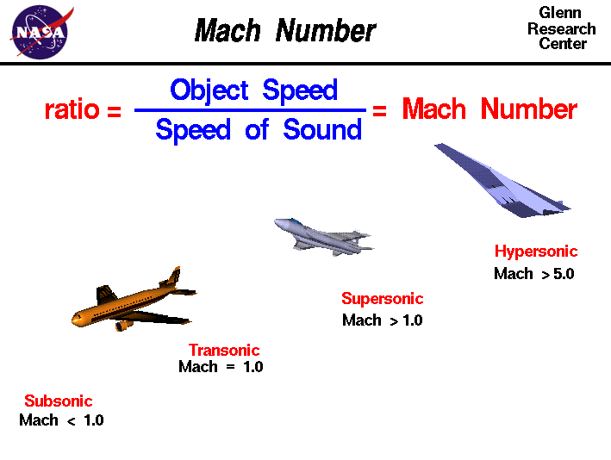
Sound waves and its velocity
** There is no upstream influence in a supersonic flow;
disturbances are only transmitted downstream.
** Flight faster than sound was thought to be impossible. In fact, the sound barrier was only an increase in the drag near sonic conditions because of compressibility effects. Because of the high drag associated with compressibility effects, aircraft do not cruise near Mach 1.

Slide 7
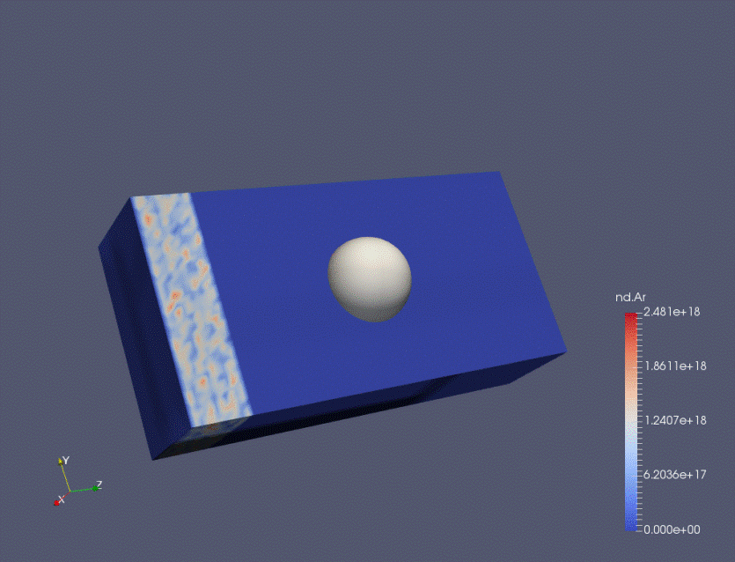

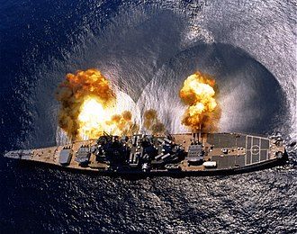
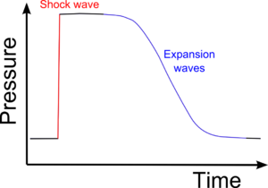
Shock Wave and Sonic Boom
In physics, a shock wave or shock, is a type of propagating disturbance. When a wave moves faster than the local speed of sound in a fluid, it is a shock wave. Like an ordinary wave, a shock wave carries energy and can propagate through a medium; however, it is characterized by an abrupt, nearly discontinuous change in pressure, temperature and density of the medium
Photograph of an attached shock on a sharp-nosed supersonic body.
Development of a shock wave for the flow past a solid
USS Iowa firing a broadside during training exercises in Puerto Rico, 1984. Shockwaves from the firing of the guns can clearly be seen in the water.

Slide 8
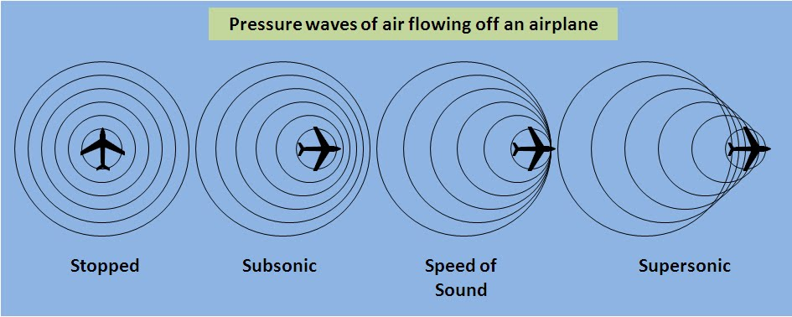
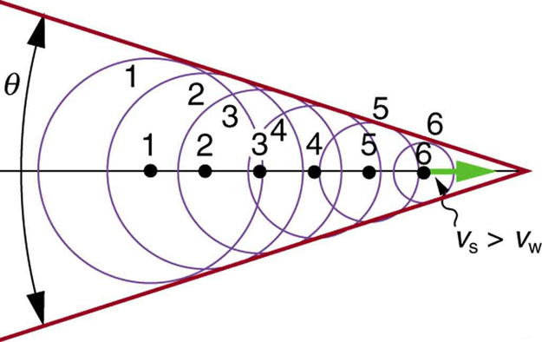
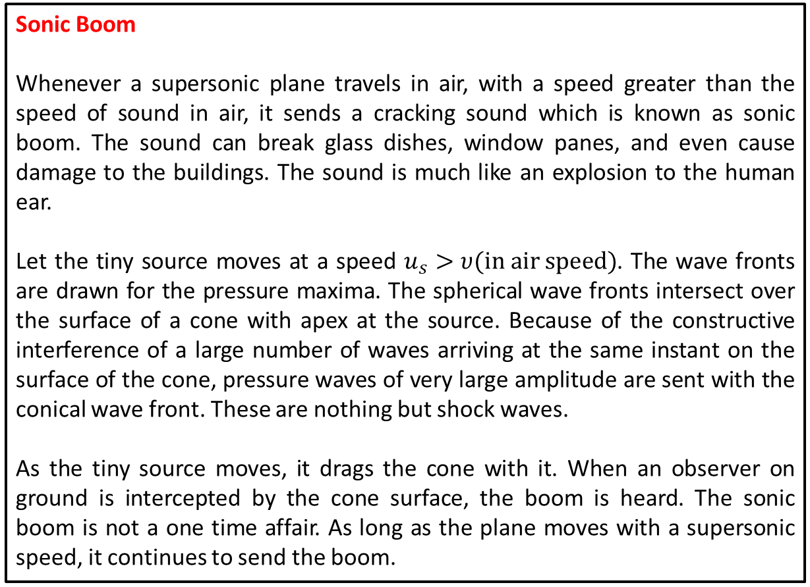
Shock Wave and Sonic Boom
Sonic Boom
Whenever a supersonic plane travels in air, with a speed greater than the speed of sound in air, it sends a cracking sound which is known as sonic boom. The sound can break glass dishes, window panes, and even cause damage to the buildings. The sound is much like an explosion to the human ear.
Let the tiny source moves at a speed $u_{s}>υ(in air speed)$. The wave fronts are drawn for the pressure maxima. The spherical wave fronts intersect over the surface of a cone with apex at the source. Because of the constructive interference of a large number of waves arriving at the same instant on the surface of the cone, pressure waves of very large amplitude are sent with the conical wave front. These are nothing but shock waves.
As the tiny source moves, it drags the cone with it. When an observer on ground is intercepted by the cone surface, the boom is heard. The sonic boom is not a one time affair. As long as the plane moves with a supersonic speed, it continues to send the boom.
The sound source is travelling at 1.4 times the speed of sound (Mach 1.4). Since the source is moving faster than the sound waves it creates, it leads the advancing wave front.
The crack of a supersonic bullet passing overhead or the crack of a bullwhip are examples of a sonic boom in miniature.

